Slide 1
Module 6 – Data Visualization & Storytelling

Slide 2
Charts & Plots
matplotlib, seaborn, plotly

Slide 3
Class 1
Line plots, bar charts, and histograms
- Label plots

Slide 4
Visualization libraries in Python
Matplotlib
A comprehensive library for creating static, animated, and interactive visualizations in Python. Matplotlib is designed to work with NumPy arrays and pandas dataframes and is highly customizable.

Slide 5
Visualization libraries in Python
Seaborn
A popular open-source Python library used for creating attractive and informative statistical graphics. Built on top of Matplotlib, it provides a high-level interface that allows for the creation of complex visualizations with less code and includes built-in themes and colour palettes. It integrates closely with pandas DataFrames to simplify data exploration.

Slide 6
Visualization libraries in Python
Plotly
An interactive, open-source, and browser-based graphing library. It offers Python-based charting, powered by plotly. js. The library ships with over 30 chart types, including scientific charts, 3D graphs, statistical charts, SVG maps, financial charts, and more.

Slide 7
Visualization libraries in Python
Matplotlib (from matplotlib import pyplot as plt)
Use plt.
Seaborn (import seaborn as sns)
Use sns.
Plotly (import plotly.express as px)
Use px.

Slide 8
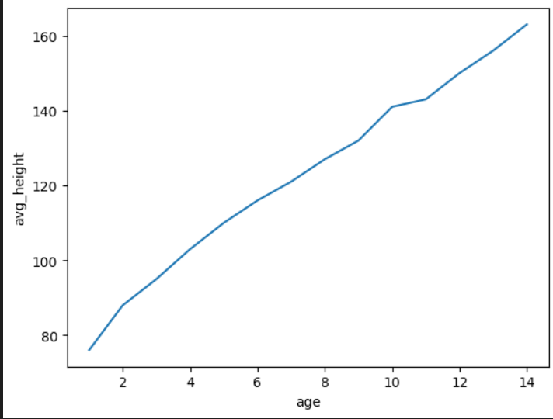
Line Plots
A line plot (or line graph/chart) displays information as a series of data points connected by straight line segments, making it ideal for visualizing trends over continuous data, typically time. It is used to track changes over days, months, or years, comparing multiple series, and forecasting future data trends.

Slide 9



Line Chart
In your notebook:
Make and view the line graph with each library.
What differences do you see between the libraries?

Slide 10
Comparing visualization libraries
Matplotlib has a different argument format (although in matplotlib you can use the seaborn format too)
Both (df.age, df.avg_height) and (data=df, x="age", y="avg_height") can be used in matplotlib
Seaborn automatically labels x and y axes
Plotly shows information if user hovers over a data point

Slide 11
Adding labels to seaborn and matplotlib graphs
plt.title("Average Height by Age")
plt.xlabel("Age")
plt.ylabel("Average Height")
If you want to add a legend:
plt.legend()

Slide 12
Adding labels to plotly graphs
Add arguments directly into the function, for example:
px.line(
df,
x="age",
y="avg_height",
title="Average Height by Age",
labels={
"age": "Age",
"avg_height": "Average Height"
}
)

Slide 13
In your notebook..
In your notebook, add labels to the graph

Slide 14
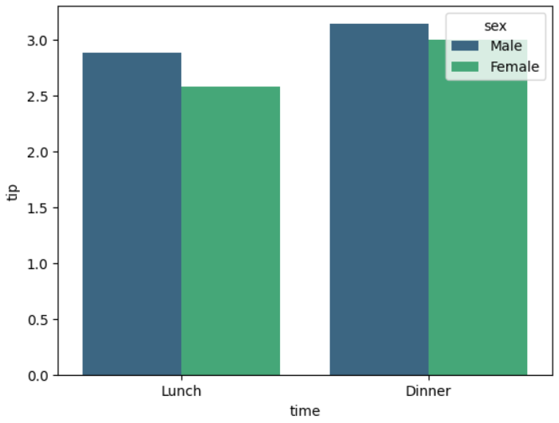
Bar charts
Bar charts are used to compare values across different categories or groups. They display data using rectangular bars, where the height (or length) of each bar represents the size or magnitude of the value.

Slide 15
Bar charts
To make a bar chart, use:
plt.bar()
sns.barplot()
px.bar()

Slide 16
Bar charts
Arguments:
In plotly, try adding the color argument. color="choose_a_variable"
Do the same in seaborn, except instead of color, call it hue.

Slide 17
Bar charts
Arguments:
In plotly, try adding or taking away the argument barmode="group"
In seaborn, estimator can be 'median'/'min'/'max'/'mean' - what does that mean?
In seaborn, try adding or taking away the errorbar=None argument

Slide 18
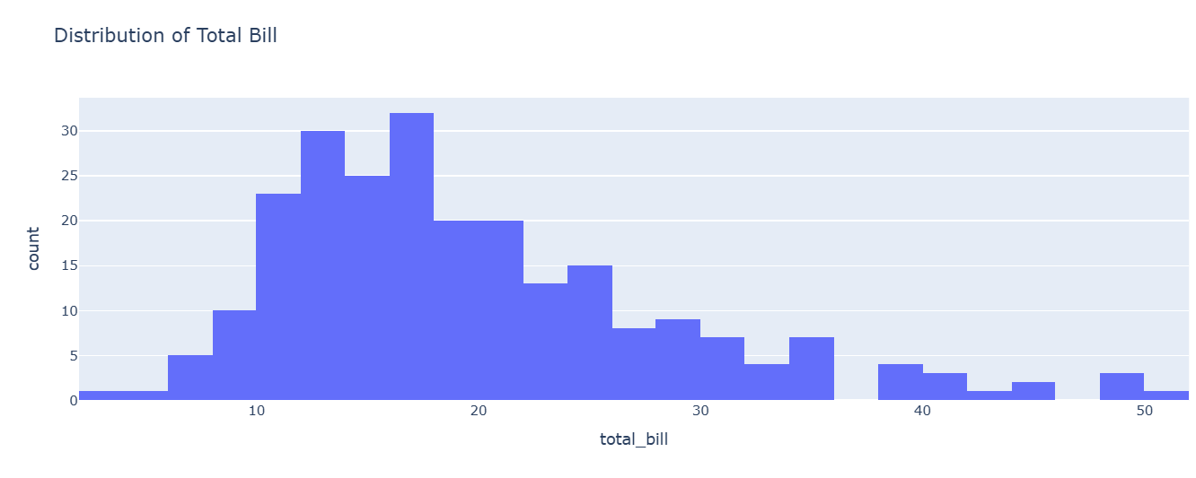
Histograms
A histogram is a type of chart that shows how often values occur in a dataset. It groups the data into intervals (called bins) and displays a bar for each interval, where the height of the bar represents the number of observations in that interval.

Slide 19
Histograms
How is it different from a bar chart?
- Bar chart → compares different categories (like fruits)
- Histogram → shows distribution of a single numeric variable (like ages, test scores, heights)

Slide 20
Histograms
plt.hist()
sns.histplot()
px.histogram()

Slide 21
Histograms
Arguments - try changing these values and see what happens:
nbins(plotly) or bins(seaborn and matplotlib)
hue (sns) or color (px)

Slide 22
Exporting the Graph
When you run plt.show() the chart only appears in the notebook or Python window and disappears when you close it.
With plt.savefig() you export the chart to a file that you can reuse elsewhere.
Seaborn uses the same plt.savefig()

Slide 23
Exporting the Graph
Plotly uses fig.write_image(), but you need to install kaleido library first or it won’t work.
pip install kaleido
Or if you want to keep interactivity:
fig.write_html()

Slide 24
Exporting the Graph
Common file formats you can save:
plt.savefig("chart.png") # most common
plt.savefig("chart.jpg")
plt.savefig("chart.pdf") # great for reports
plt.savefig("chart.svg") # scalable graphics
If you need it in high resolution (e.g. for reports or printing) you should also add a dpi (dots per inch) value of 300:
plt.savefig("chart.png", dpi=300)

Slide 25
HOMEWORK
Create 3 visuals using matplotlib, - choose whatever visuals you like, get creative with your datasets

Slide 26
Resources
Matplotlib Docs
DataCamp Intro to Plotting
Data Visualization using Matplotlib in Python – GeeksforGeeks
W3Schools Matplotlib Tutorial

Slide 27
Class 2
Scatterplots, heatmaps, pairplots
Explore relationships
Add color and style to plots

Slide 28
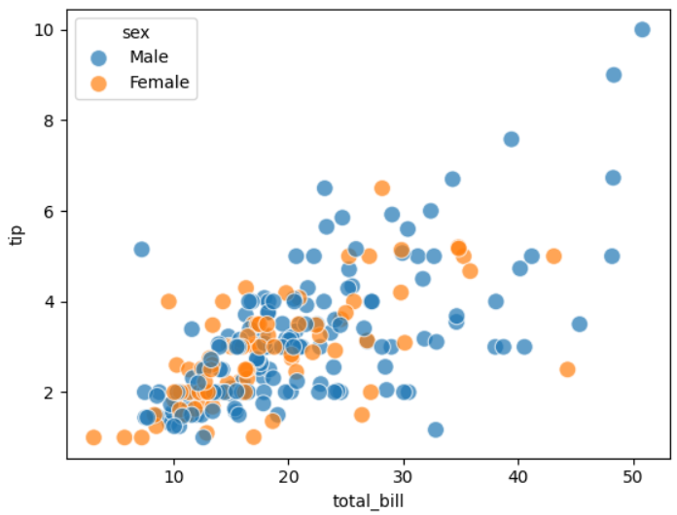
Scatter plots
A uses dots to represent values for two different numeric variables. Scatter plots’ primary uses are to observe and show relationships between two numeric variables. The dots in a scatter plot not only report the values of individual data points, but also patterns when the data are taken as a whole.

Slide 29
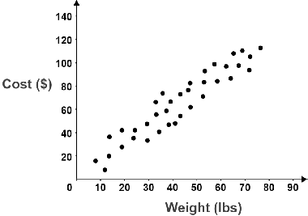
Scatterplot relationship
According to this image, what can you infer about weight and cost?

Slide 30
Scatterplot relationship
Weight and cost are positively correlated - as weight goes up, so does cost.

Slide 31
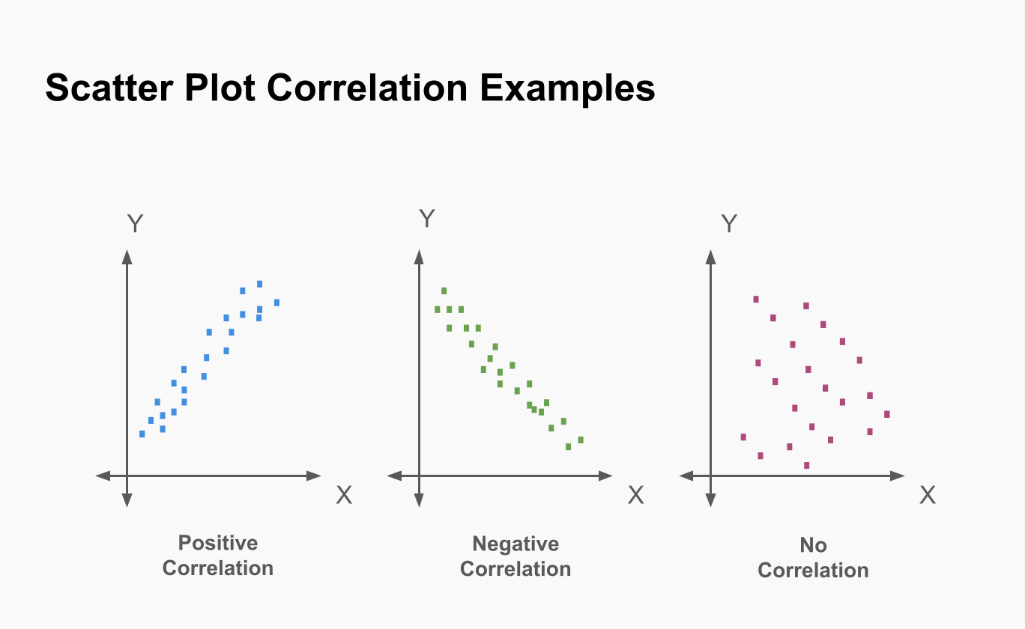
Scatterplot relationship

Slide 32
Scatter plots
plt.scatter(data=…, x=’…’, y=’…’)
sns.scatterplot(data=…, x=’…’, y=’…’)
px.scatter(data, x=”…”, y=”…”)

Slide 33
Plot arguments
Optional arguments:
hue(sns) - adds colour grouping based on a category
color(plotly) - controls the colour of the plot
s - controls the size of points
Alpha - opacity (transparency) (alpha = 1 - fully solid, alpha = 0 – invisible, alpha = 0.3 → semi-transparent)
Argument in plotly: hover_data=["variable1", "variable2"]
Try changing the optional arguments around in your notebook to figure out what they do.

Slide 34
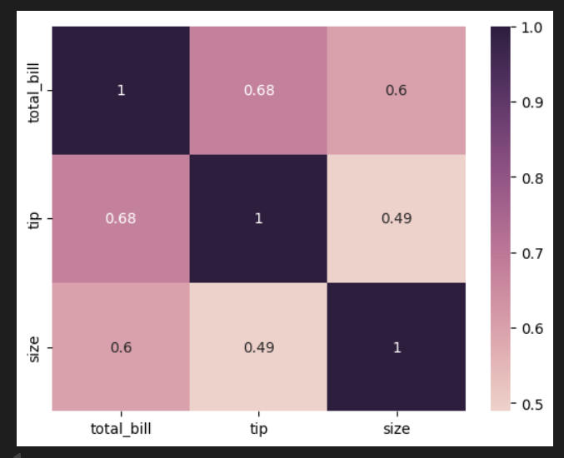
Heatmaps
Use heatmaps to visualize complex datasets, identify patterns, or detect hotspots across two dimensions using colour intensity. They are best for spotting trends in large datasets, optimizing website user experience (UX) via click/scroll behaviour, analysing spatial data, and identifying outliers. Heatmaps turn dense numerical data into intuitive visual insights.

Slide 35
Heatmaps
What do you think the numbers and colors in the chart represent?

Slide 36
Heatmaps
1 is perfect correlation.
Values closer to 0 show no correlation
Values closer to -1 show negative correlation
Values closer to 1 show positive correlation

Slide 37
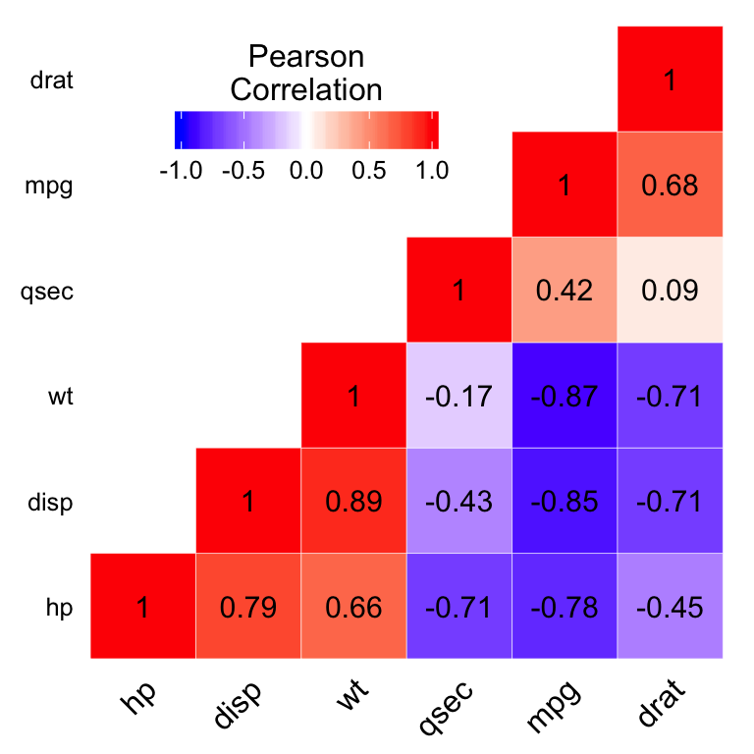
Heatmap relationship
According to this graph, which two variables are the most negatively correlated?

Slide 38
Heatmap relationship
According to this graph, which two variables are the most negatively correlated?
Mpg and wt

Slide 39
Heatmap relationship
According to this graph, which two variables are the least correlated?

Slide 40
Heatmap relationship
According to this graph, which two variables are the least correlated?
Drat and qsec

Slide 41
Heatmaps
sns.heatmap(numerical_df.corr(), annot=True)
annot=True - adds the actual correlation values inside each cell
.corr() - computes the correlation matrix
px.imshow(numerical_df.corr())

Slide 42
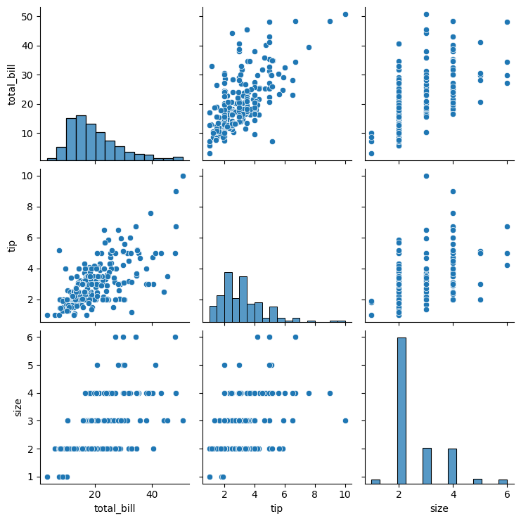
Pairplots
Use a pairplot during initial Exploratory Data Analysis (EDA) to visualize pairwise relationships, distributions, and correlations across multiple numerical variables simultaneously. It is best used to quickly identify trends, clusters, outliers, and linear/non-linear relationships in a dataset.

Slide 43
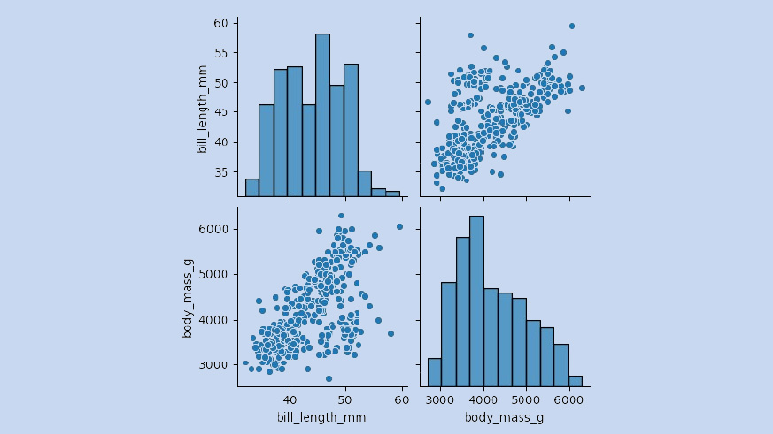
Pairplot relationship
Pair plots, or scatterplot matrices, visualize relationships between all numerical variables in a dataset by creating a grid of subplots. They pair each variable with every other, using scatter plots for relationships (off-diagonal) and histograms or kernel density plots (KDE) to show individual distributions (diagonal).
Notes:
https://seaborn.pydata.org/generated/seaborn.pairplot.html

Slide 44
Pairplot relationship
In the pairplot, do body mass and bill length show any relationship?

Slide 45
Pairplot relationship
In the pairplot, do body mass and bill length show any relationship?
They show a positive correlation.

Slide 46
Pairplots
sns.pairplot(df)
px.scatter_matrix(df)
In your notebook, try adding hue or color arguments

Slide 47
Extra charts

Slide 48
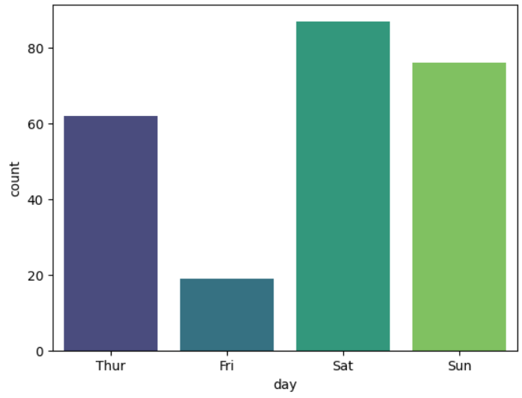
Count plots
A countplot is a type of categorical plot in the Seaborn library that displays the frequency (count) of observations in each category using bars. It acts as a histogram for categorical variables rather than continuous numerical data.

Slide 49
Count plots
sns.countplot(data=tips, x='…')

Slide 50
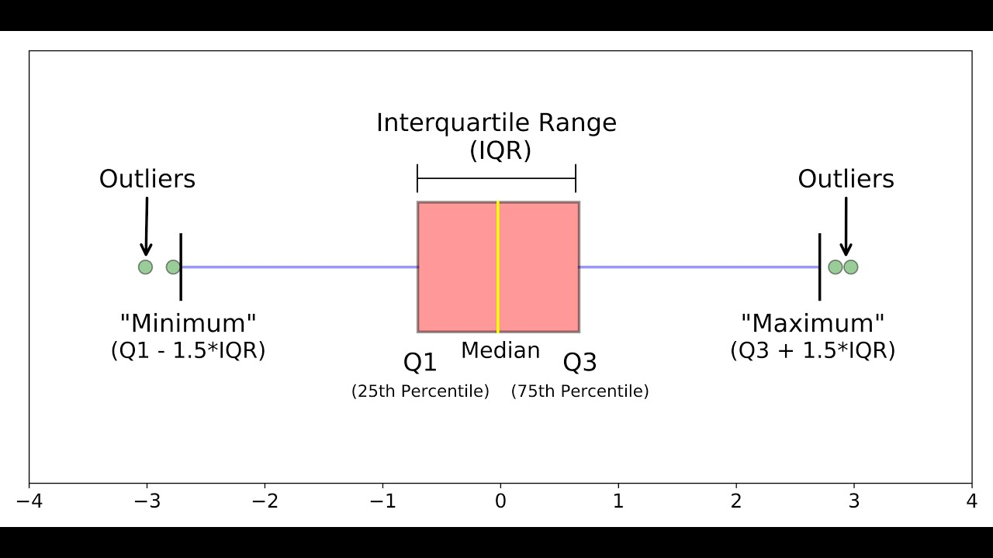
Box plots
Notes:
https://www.geeksforgeeks.org/data-visualization/what-is-box-plot-and-the-condition-of-outliers/
https://www.atlassian.com/data/charts/box-plot-complete-guide
https://www.kdnuggets.com/2019/11/understanding-boxplots.html

Slide 51
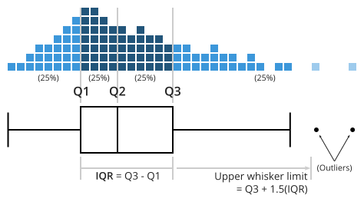
Box plots
Notes:
https://www.atlassian.com/data/charts/box-plot-complete-guide

Slide 52
Box plots
Boxplots (box-and-whisker plots) are best used for comparing distributions across multiple groups, identifying outliers, and understanding data spread (variance, skewness, and symmetry) at a glance.
Box limits indicate the range of the central 50% of the data, with a central line marking the median value. Lines extend from each box to capture the range of the remaining data, with dots placed past the line edges to indicate outliers.

Slide 53
Box plots
sns.boxplot(data=…, x=‘…', y=‘…')
px.box(data, x=“…", y=“…")

Slide 54
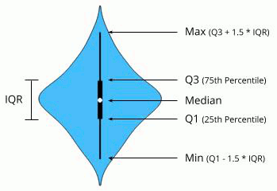
Violin plots
Violin plots are best used to compare the density and distribution shape of continuous numerical data across multiple categories (typically 2-7 groups). Unlike box plots, they reveal multi-modal data, peaks, and valleys in distribution, making them ideal for exploring data that isn't normally distributed, such as survey results, test scores, or scientific measurements.

Slide 55
Violin plots
sns.violinplot(data=…, x=‘…', y=‘…')
px.violin(data, x=“…", y=“…")

Slide 56
Improving the visualizations
Artificial Intelligence can help you make your graphs much more attractive. Before using AI, it is important to have an idea of what you want to show with the data and the type of graph you want to use - then AI can make it look better by adding titles, labels, pretty colors, and more.

Slide 57
Homework
Seaborn visualization challenges
Learn Data Visualization | Kaggle

Slide 58
Resources
Main differences between matplotlib, seaborn, and plotly | datons.com
An introduction to seaborn — seaborn 0.13.2 documentation
Learn Data Visualization | Kaggle

Slide 59
Class 3
Chart selection: Matching visuals to data types
Avoid misleading visuals

Slide 60
Line graph
When would you use a line chart?
Brainstorm some examples.

Slide 61
Line graph
Use a line chart when the x-axis is ordered and you care about change or trend.
Showing Change Over Time. Ex: Hourly temperature readings across a day
Comparing Trends Between Groups (multiple lines). Ex: Sales over time by region
Showing Averages or Aggregated Trends. Ex: Mean test score by grade level

Slide 62
Scatter plot
When would you use a scatter plot?
Brainstorm some examples

Slide 63
Scatter plot
Use scatter plots to explore relationships or correlations between two numerical variables. Ex: Hours studied and exam score - does studying more hours show a relationship with grades?
Check for clusters. Ex: Height vs. weight, colored by gender - Are there separate clusters for men and women?
Spot outliers

Slide 64
Bar Graph
When would you use a bar chart?
Brainstorm some examples

Slide 65
Bar Graph
Use a bar chart when you want to compare discrete categories, not show trends
Comparing Values Across Categories. Ex: Number of customers by subscription plan
Ranking or Ordering Categories. Ex: Countries by population
Comparing Aggregated Metrics - What is the average / total / count per category?. Ex: Total sales by month

Slide 66
Count plots
When would you use a countplot?
Brainstorm some examples

Slide 67
Count plots
Compare category frequencies
Detect imbalances - Are some categories over or under represented?

Slide 68
Histograms
When would you use a histogram?
Brainstorm some examples

Slide 69
Histograms
Understanding the shape of data - Ex: Exam scores for a class
Is it normally distributed? Skewed left or right? Are there multiple peaks (bimodal)?
Checking for outliers - extremely high or low values
Understanding your data - as a quick check for numerical data distributions in general in your dataset.

Slide 70
Heatmaps
When would you use a heatmap?
Brainstorm some examples.

Slide 71
Heatmaps
Use heatmaps to show correlations

Slide 72
Box plots and violin plots
Use box plots or violin plots when you want median, quartiles, spread, and outliers, especially to compare groups.
For example, to compare exam performance in different classes or house prices by neighborhood.

Slide 73
Quiz
For each scenario, choose the type of graph you would use to best visualize the data. Options: Line, Scatter, Bar, Count, Histogram, Box, Heatmap.

Slide 74
Quiz
1. A company wants to see how its monthly sales revenue has changed over the past 5 years.
2. A researcher collects data on hours studied and exam scores for 200 students to see if there’s a relationship between the two variables
3. A supermarket wants to show the total sales of different product categories (like dairy, produce, and snacks) in the last quarter.
4. A social media analyst wants to show the number of posts made by users each day of the week.
5. A teacher wants to understand the distribution of test scores for a class of 50 students.

Slide 75
Answers
1. A company wants to see how its monthly sales revenue has changed over the past 5 years. Line graph.
Line graphs show trends over time
2. A researcher collects data on hours studied and exam scores to see if there’s a relationship between the two variables. Scatter plot
Scatter plots show the relationship between two numerical variables and help identify correlations.
3. A supermarket wants to show the total sales of different product categories (like dairy, produce, and snacks) in the last quarter. Bar chart

Slide 76
Answers
4. A social media analyst wants to show the number of posts made by users each day of the week. Count plot
Count plots show frequency by category
5. A teacher wants to understand the distribution of test scores for a class of 50 students. Histogram
Histograms show distribution

Slide 77
Quiz
6. A data analyst wants to compare the median, quartiles, and outliers in salaries across three different departments in a company.
7. A meteorologist wants to visualize temperature variations across different cities and months of the year in a single chart.
8. A tech company wants to see the relationship between the number of hours spent on its app and the number of in-app purchases per user.
9. A store manager wants to visualize the most popular T-shirt sizes purchased over the past month.
10. A fitness coach wants to show the trend of weekly step counts for a group of clients over a year.

Slide 78
Answers
6. A data analyst wants to compare the median, quartiles, and outliers in salaries across three different departments in a company. Box plot
7. A meteorologist wants to visualize correlations between many weather-related variables including rainfall cm, wind speed, and temperature. Heatmap
8. A tech company wants to see the relationship between the number of hours spent on its app and the number of in-app purchases per user. Scatter plot
9. A store manager wants to visualize the most popular T-shirt sizes purchased over the past month. Countplot

Slide 79
Avoid misleading values

Slide 80
Correlation≠ Causation
https://www.tylervigen.com/spurious-correlations
What is the difference between correlation and causation?

Slide 81
Colors
Be careful with colors
For example:
Red/green scales can imply good/bad
Too many colors can be distracting
Very similar colors for different values make charts difficult to read
Remember color blindness is pretty common

Slide 82
Chart choice mistakes
Don't use a line chart for unordered data
Don't use a pie chart with too many slices

Slide 83
Practice
In the notebook, practice by fixing the misleading or bad graphs.

Slide 84
Homework
Create a misleading chart.
Explain why it is misleading.
Show how to fix it.

Slide 85
Resources
From Data to Viz
Data Journalism: Interpreting Visuals

Slide 86
Data storytelling frameworks

Slide 87
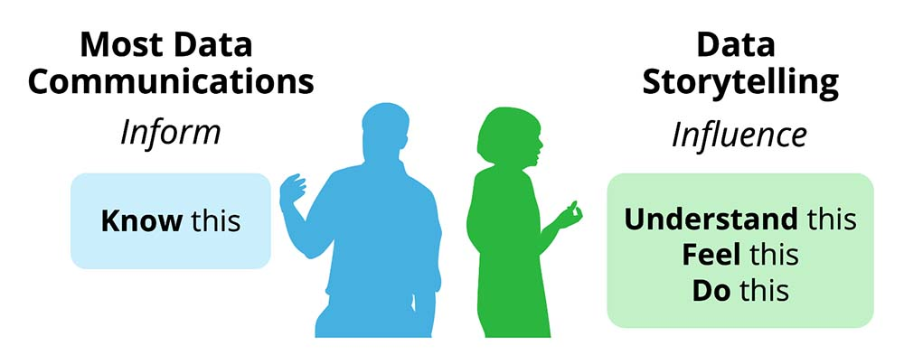
Data Storytelling
Notes:
https://www.effectivedatastorytelling.com/post/data-storytelling-101-a-beginners-guide-to-turning-insights-into-action

Slide 88
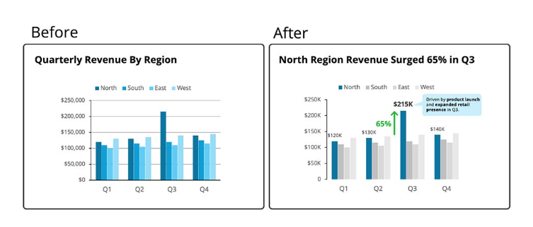
Why do we need it?
Notes:
Source: https://www.effectivedatastorytelling.com/post/data-storytelling-101-a-beginners-guide-to-turning-insights-into-action

Slide 89

Data Storytelling Frameworks
Audience Understanding
Effective data storytelling begins by understanding the audience's needs, preferences, and background to tailor the narrative.
Clear Message Definition
Defining a concise, focused message helps drive the story and ensures clarity throughout the presentation.
Supporting Visuals
Using charts, graphs, and imagery makes key insights more impactful and helps viewers understand complex data easily.
Storytelling Frameworks
Frameworks guide viewers through engaging narratives that drive understanding and action.
Notes:
Image source: Microsoft 365 content library Data storytelling frameworks help structure complex information into compelling narratives. They emphasize understanding the audience, defining a clear message, and using visuals to support key insights. Utilizing frameworks such as the Hero’s Journey or Problem-Solution-Benefit enhances engagement by guiding viewers through data-driven stories that inspire action and understanding.

Slide 90
Data Storytelling Frameworks
1. OIA (Observation-Insight-Action): Best for operational teams. 1) State the Observation (data fact), 2) Explain the Insight (why it matters), 3) Define the Action (what to do).
2. SCQA Method: Structured narrative for presentations. Situation (context), Complication (problem), Question (what now?), Answer (solution).
3. DIKW Framework: Shows the analytical process from raw data to insight. Data, Information, Knowledge, Wisdom (mapping visual elements to the narrative).

Slide 91
The OIA Framework Breakdown
Observation (Data Fact): State the raw fact, data point, or behaviour observed. This is objective and verifiable
Insight (Why it Matters): Analyse the "so what?" to explain the cause or impact on the business. This adds context to the observation
Action (What to Do): Define a concrete, actionable step to take. This must be specific, measurable, and aimed at resolving the issue.

Slide 92
OIA in Action
Example: Marketing Performance
Observation: Web conversions dropped 14% this quarter.
Insight: Data shows that paid traffic quality declined, indicating low-intent users are clicking ads.
Action: Pause underperforming ad campaigns and reallocate the budget toward higher-intent organic channels.

Slide 93
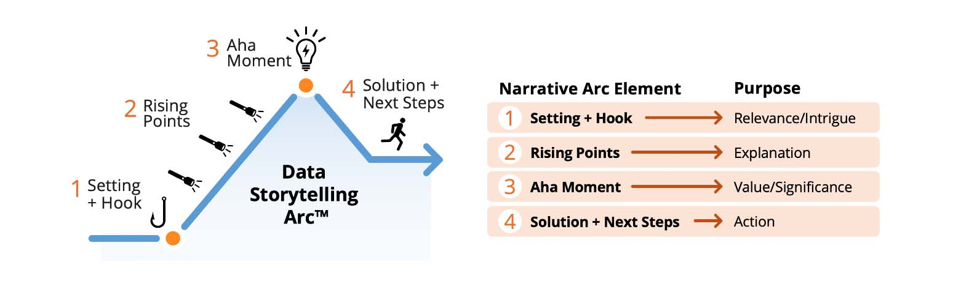
SCQA Method
Situation (context), Complication (problem), Question (what now?), Answer (solution)

Slide 94
SCQA Method in Action
Example
Situation A company has been growing steadily for the past 5 years and has a strong presence in its market.
Complication Over the last 6 months, sales have dropped by 15% despite no major internal changes.
Question What is causing the decline in sales, and how can the company reverse it?
Answer The decline is likely due to increased competition and changing customer preferences. The company should:
Reassess its pricing strategy
Improve product differentiation

Slide 95
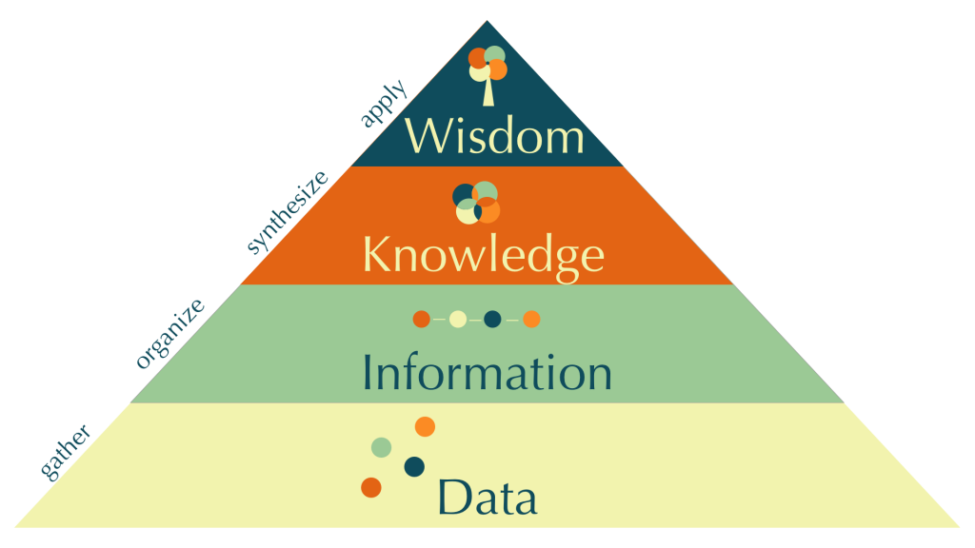
DIKW Framework

Slide 96
DIKW Framework
Shows progression from raw data to actionable insight – Helps analysts articulate the value of their work to non-technical stakeholders.
Maps naturally to storytelling – You can narrate: “We saw this (data), understood this (information), realized this (knowledge), and recommend this (wisdom).”
Supports multiple media – Can be applied in dashboards, slide decks, reports, or verbal presentations. Teaches thinking in layers – Encourages analysts to avoid “just presenting numbers” and instead link them to insights and actions.

Slide 97
DIKW Framework in Action
Example:
Data: Sales transactions per day per store
Information: Average daily sales per store; monthly trends
Knowledge: Store X underperforms on weekends due to lack of promotions.
Increase weekend promotions at Store X; forecast +15% revenue

Slide 98
Key Elements of a Data Story
Audience: Tailor the story to the audience's knowledge and technical comfort.
Narrative: Connect data points using a clear beginning, middle, and end.
Visuals: Use simple, clean visualizations that highlight key insights, avoiding distractions.

Slide 99
Resources
https://www.storytellingwithdata.com/makeovers
https://www.effectivedatastorytelling.com/post/data-storytelling-101-a-beginners-guide-to-turning-insights-into-action
https://www.dataquest.io/tutorial/telling-data-stories-with-python-using-information-design/

Slide 100
Visualization best practices

Slide 101
Lead with Insight & Purpose
Key Idea: Respect your audience’s time and answer the question.
Put the main insight upfront.
Every chart should answer a clear question.
Ask: What is this chart trying to show?
Sequence charts logically: introduction → insight → action

Slide 102
Provide Context & Meaning
Key Idea: Data without context doesn’t tell a story.
Explain what the data means, not just what it is.
Highlight patterns and insights clearly.
Guide the viewer to the story—don’t make them hunt for it.

Slide 103
Choose the Right Chart & Keep it Simple
Key Idea: Match visualization to the goal and keep it clear.
Select chart type based on purpose:
Comparison → Bar/Column
Trend → Line/Area
Distribution → Histogram/Box plot
Relationship → Scatter/Bubble
Composition → Stacked Bar/Pie (sparingly)
Use clear language; avoid unnecessary jargon.
Show only what matters—less is more.

Slide 104
Declutter & Highlight Key Insights
Key Idea: Make visuals easy to understand and focus on the story.
Remove unnecessary elements (3D effects, extra gridlines).
Label axes clearly but concisely.
Use color, size, or annotations to guide attention.

Slide 105
Consistency, Scale & Interactivity
Key Idea: Make charts reliable and easy to compare.
Use consistent colors, fonts, and scales.
Keep category colors uniform across charts.
Avoid misleading axes; use meaningful aggregations (sum, average, median).
Interactive features (filters, tooltips) can enhance exploration but keep it simple.

Slide 106
Mini-project: Create a narrative visual report for a business dataset

Slide 107
Quiz

Slide 108
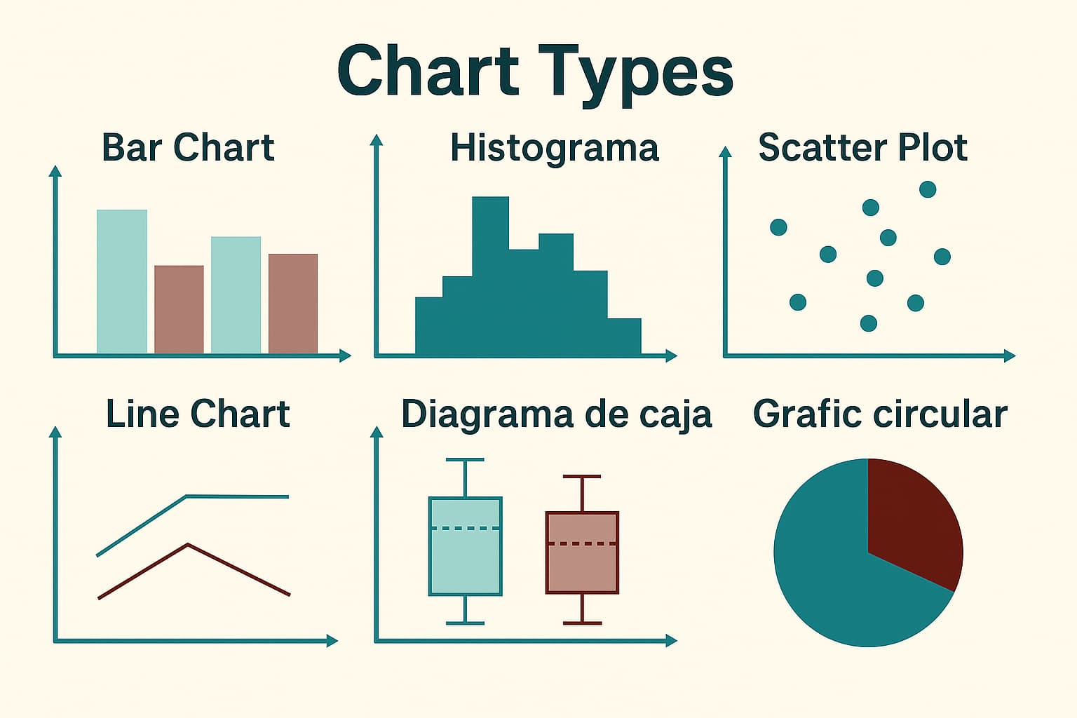
What are these charts called?

Slide 109
What are these charts called?

Slide 110
Questions
What kind of the chart would you choose to…
Count the number of times different brands appear in a dataset
Show the distribution of ages in a dataset
Compare the average study hours of different levels of students
See if there is a relationship between study hours and test scores
View a stock price over time
Find correlations within a dataset

Slide 111
Answers
What kind of the chart would you choose to…
Count the number of times different brands appear in a dataset
countplot
Show the distribution of ages in a dataset
histogram
Compare the average study hours of different student groups
Bar plot

Slide 112
Answers
What kind of the chart would you choose to…
See if there is a relationship between study hours and test scores
Scatter plot
View a stock price over time
Line plot
Find correlations within a dataset
Heat map

